Slide 1
Windows Hooks
Executing your own code in another process

Slide 2
About Me
Programming for 10 years, but not very well
I work with C/C++, Java, and C# (learning Haskell)
Primarily Java
Joined InfoSec to learn Reverse Engineering
Think it’s really cliché we meet in the most remote, out-of-the-way room in a basement
Previously worked at Cyber Command
There I learned everything I know about networking
I’m willing to teach programming and partner with anyone on a project

Slide 3
What is a Windows Hook?
Enables reading and modifying a remote process
Good for developing malware or cheating at enabling increased functionality in games
Learning and using Metasploit makes all this much easier (I still haven’t done that…)
Also, CheatEngine has much of the functionality you may be looking for

Slide 4
DLL Injection

Slide 5
DLL Injection
Simpler, and has fewer memory and reference restrictions
Can be more detectable by the target process
Attaches to the target process from another process, then copies a DLL or DLL Path into the target’s memory
Starts the execution of your DLL from within the target

Slide 6
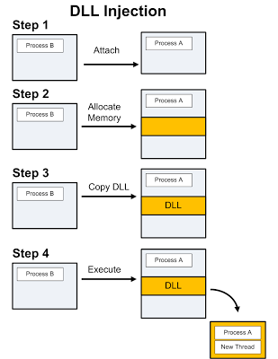

Slide 7
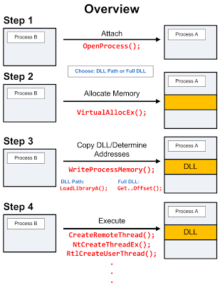
Notes:
Steps:
Attach to the process: OpenProcess
Allocate memory within the process: VirtualAllocEx
Copy the DLL or DLL Path into the target process: WriteProcessMemory, LoadLibraryA or GetMemoryOffset
Instruct the target to execute the DLL: CreateRemoteThread, NtCreateThreadEx, RtlCreateUsereThread, etc…

Slide 8
LoadLibraryA
kernel32.dll function that loads DLLs, executables, and other libraries at run time
It’s only parameter is a filename
Memory is only allocated for the path to the DLL
Notes:
Steps:
Allocate memory for the path to the DLL
Set the target process’s execution starting point to the address of LoadLibraryA
DLL path memory is the only parameter

Slide 9
CreateRemoteThread & WriteProcessMemory
Avoids the problems with writing DLLs and registering them with the target process (it’s less detectable by target process)
Has memory and DLL reference limitations
Uses the WriteProcessMemory API to copy arbitrary code to a remote process
Starts the code’s execution with CreateRemoteThread

Slide 10
CreateRemoteThread
Uses a Handle to connect to a remote proocess
HANDLE CreateRemoteThread(
HANDLE hProcess
LPSECURITY_ATTRIBUTES lpThreadAttributes,
DWORD dwStackSize,
LPTHREAD_START_ROUTINE lpStartAddress,
LPVOID lpParameter
DWORD dwCreationFlags,
LPDWORD lpThreadId,
);
HANDLE for the target process
pointer to security attributes
thread’s stack size (in bytes)
pointer to thread’s start point
arguments for thread
creation flags
thread’s ID
Notes:
Steps:
Retrieve a HANDLE to the remote process: OpenProcess
Allocate memory in the target process’s address space for injected data: VirtualAllocEx
Write a copy of the initialized INJDATA structure to the allocated memory: WriteProcessMemory
Allocate memory in the target process’s address space for injected code: VirtualAllocEx
Write a copy of ThreadFunc to the allocated memory
Rules:
Call only functions from kernel32.dll and user32.dll
Pass all strings to ThreadFunc via INJDATA
Remove the /GZ compiler switch, which is set by default in debug builds
Declare ThreadFunc and AfterThreadFunc as static
Use less than 4kb for local variables in ThreadFunc
Use if-else if sequences instead of switch-case blocks
Start the remote copy of ThreadFunc: CreateRemoteThread
Wait for the remote thread to terminate: WaitForSingleObject
Retrieve the result from the remote process: ReadProcessMemory or GetExitCodeThread
Free the memory allocated in #2/4: VirtualFreeEx
Close the HANDLEs retrieved in #1/6: CloseHandle

Slide 11
Resources
Antoniewicz, Brad. “Windows DLL Injection Basics”. 08Jan2013. Open Security Research. blog.opensecurityresearch.com/2013/01/windows-dll-injection-basics.html
Kuster, Robert. “Three Ways to Inject Your Code into Another Process”. 20Aug2003. Code Project. http://www.codeproject.com/Articles/4610/Three-Ways-to-Inject-Your-Code-into-Another-Proces
Rolles, Rolf. “What is DLL Injection and how is it used for reversing?”. Reverse Engineering Stack Exchange. https://reverseengineering.stackexchange.com/questions/2252/what-is-dll-injection-and-how-is-it-used-for-reversing
Further Reading
https://web.archive.org/web/20140702010436/http://codingthewheel.com/tags/poker-bot/ - Suggested by Rolf Rolles and is great reading about using DLL injection to auto-play poker, perhaps the most legitimate, non-trivial use of which I can think.

